Slide 1
GOES-R ABI Cloud Cover Layers L2 Provisional Validation
Peer/Stakeholder Product Validation Review (PS-PVR)
May 16, 2023
AWIPS Verification / NWS Perspective
Derek Van Pelt, Lee Byerle, John Evans
TOWR-S team, NWS Office of Observations
Best viewed in Google Slides

Slide 2
Notes on GOES-R Cloud Cover Layers & AWIPS
AWIPS can ingest & display the 2-D fields in the CCL product:
Total Cloud Fraction (TCF)
Cloud Layer Flag (CL)
+ Data Quality Flag (DQF), used as a mask
Adherence to CF Conventions:
Variable “TCF” should have the Standard Name “cloud_area_fraction”

Slide 3
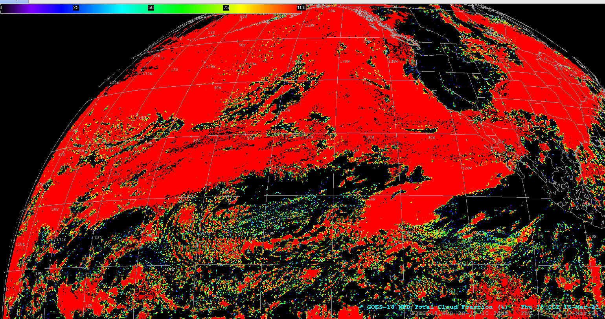
Total Cloud Fraction

Slide 4
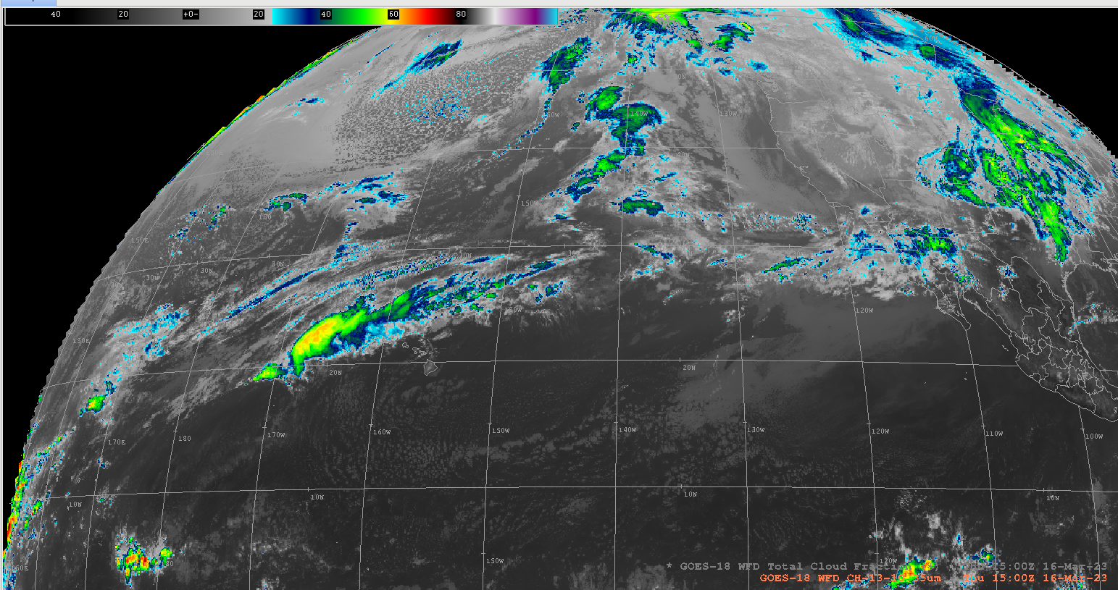
Total Cloud Fraction: ABI Ch. 13 comparison

Slide 5
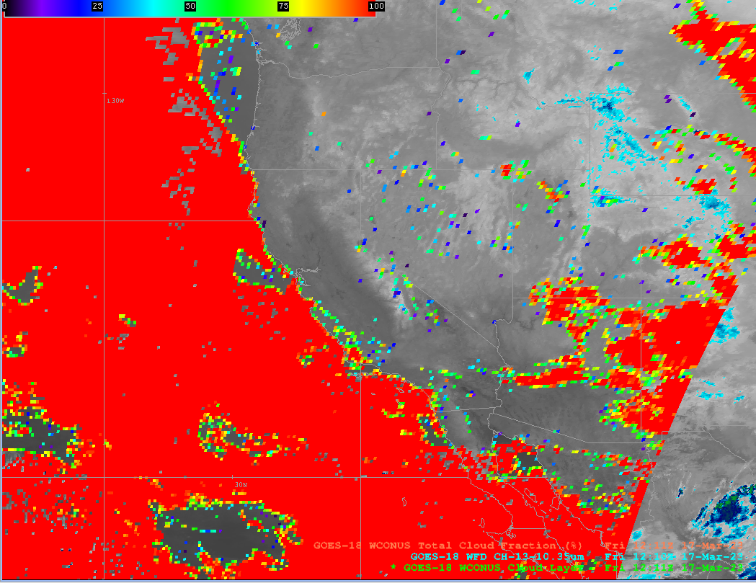
Total Cloud Fraction

Slide 6
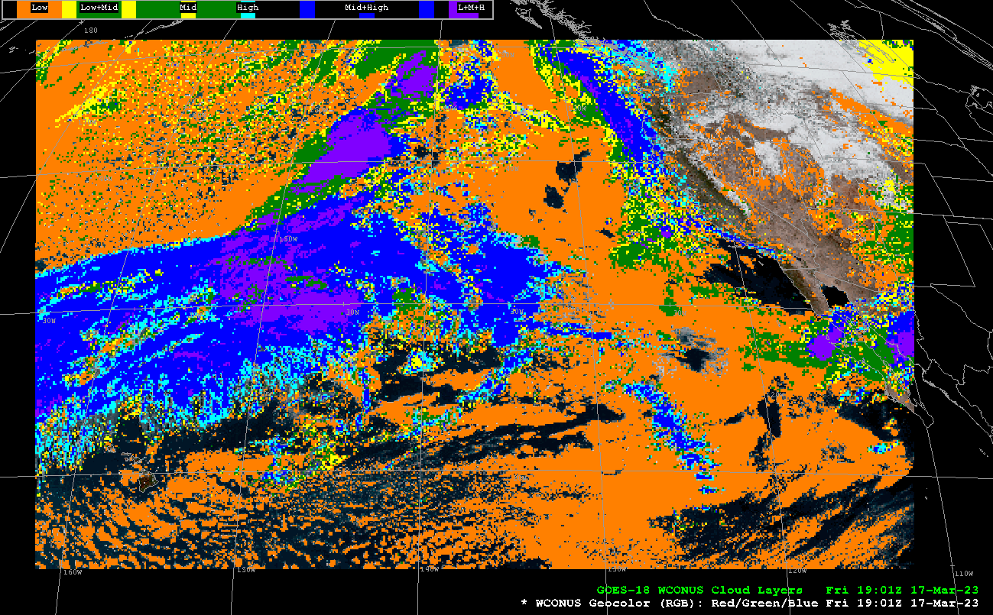
(binary) Cloud Layers

Slide 7
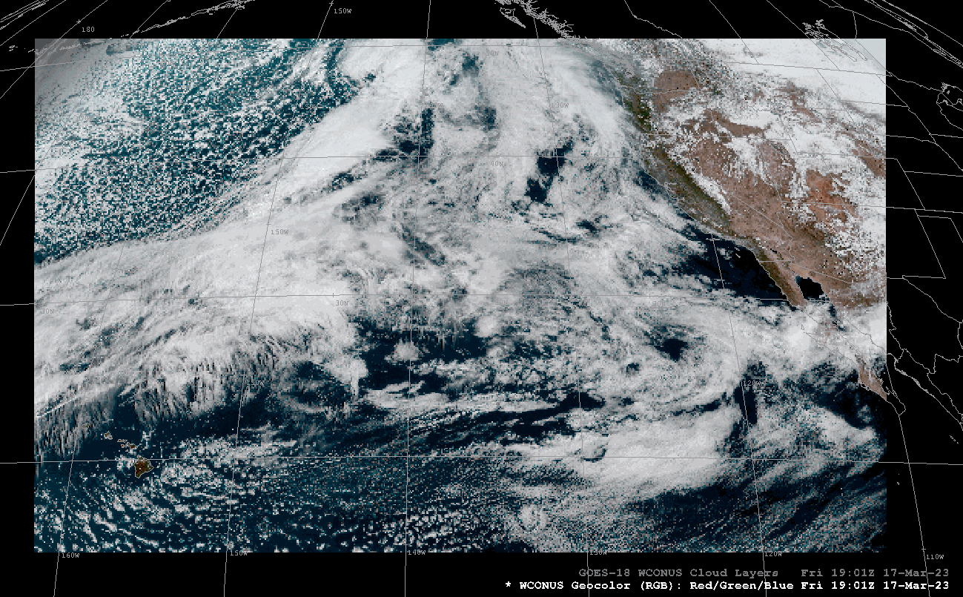
Cloud Layers: CIRA Geocolor comparison

Slide 8
More notes on GOES-R Cloud Cover Layers & AWIPS
AWIPS cannot handle the 3-D “Cloud Fractions Packed” (CFP) field
Looking forward to next CCL product with Cloud Fractions structured as five 2-D fields (July 2023?)
But in the meantime, AWIPS can use Cloud Layer Flag (CL) bits (00000…11111) to display cloud presence / absence in each of 5 layers:
Define 5 AWIPS parameters (CL[1-5]) from the one CL field in the NetCDF; Define 5 color schemes based on bit values (instead of value ranges)
Adherence to CF Conventions:
Dimension “NumFlt_Layers” (used by CFP) needs a coordinate variable “NumFlt_Layers” listing the 5 vertical intervals
Variable “CFP” should have the Standard Name “cloud_area_fraction_in_atmosphere_layer”

Slide 9
More notes on GOES-R Cloud Cover Layers & AWIPS
Option 1: Single color table based on value ranges —>
Binary | Decimal | Cloud Layers
00000 | 0
00001 | 1 |  |  |  |  | LOW1
00010 | 2 |  |  |  | LOW2
00011 | 3 |  |  |  | LOW2 | LOW1
00100 | 4 |  |  | MID1
00101 | 5 |  |  | MID1 |  | LOW1
00110 | 6 |  |  | MID1 | LOW2
00111 | 7 |  |  | MID1 | LOW2 | LOW1
01000 | 8 |  | MID2
01001 | 9 |  | MID2 |  |  | LOW1
01010 | 10 |  | MID2 |  | LOW2
01011 | 11 |  | MID2 |  | LOW2 | LOW1
01100 | 12 |  | MID2 | MID1
01101 | 13 |  | MID2 | MID1 |  | LOW1
01110 | 14 |  | MID2 | MID1 | LOW2
01111 | 15 |  | MID2 | MID1 | LOW2 | LOW1
10000 | 16 | HIGH
10001 | 17 | HIGH |  |  |  | LOW1
10010 | 18 | HIGH |  |  | LOW2
10011 | 19 | HIGH |  |  | LOW2 | LOW1
10100 | 20 | HIGH |  | MID1
10101 | 21 | HIGH |  | MID1 |  | LOW1
10110 | 22 | HIGH |  | MID1 | LOW2
10111 | 23 | HIGH |  | MID1 | LOW2 | LOW1
11000 | 24 | HIGH | MID2
11001 | 25 | HIGH | MID2 |  |  | LOW1
11010 | 26 | HIGH | MID2 |  | LOW2
11011 | 27 | HIGH | MID2 |  | LOW2 | LOW1
11100 | 28 | HIGH | MID2 | MID1
11101 | 29 | HIGH | MID2 | MID1 |  | LOW1
11110 | 30 | HIGH | MID2 | MID1 | LOW2
11111 | 31 | HIGH | MID2 | MID1 | LOW2 | LOW1

Slide 10
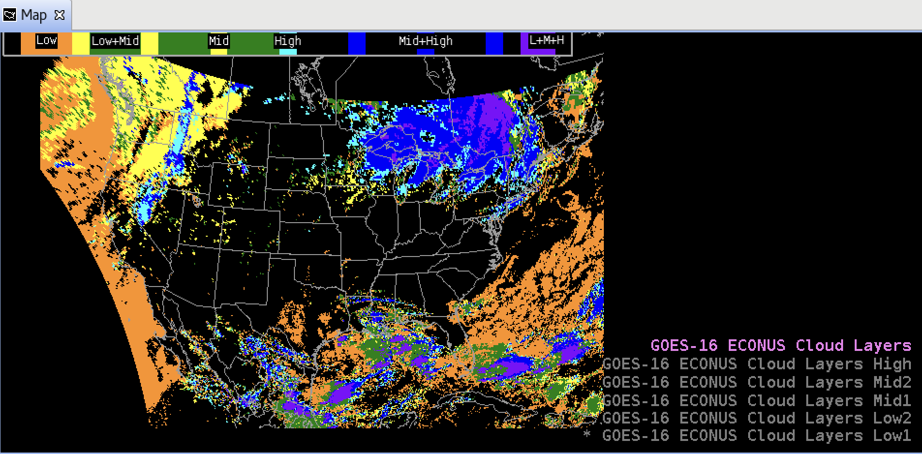
Cloud Layers: All layers

Slide 11
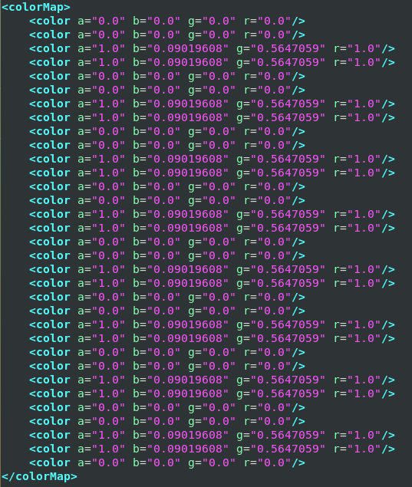
More notes on GOES-R Cloud Cover Layers & AWIPS
Cloudy vs. clear bits in 5 layers:
Bit Layer Binary Decimal
1 LOW1 xxxx1 = 1, 3, 5, 7, … , 29, 31
2 LOW2 xxx1x = 2-3, 6-7, … , 30-31
3 MID1 xx1xx = 4-7, 12-15, … , 28-31
4 MID2 x1xxx = 8-15, 24-31
5 HIGH 1xxxx = 16-31
Option 2: Use a color for each bit – e.g.,
LOW1: 1, 3, 5, 7, 9, 11, … 31
LOW2: 2-3, 6-7, 10-11, … 30-31
MID1: 4-7, 12-15, 20-23, …, 28-31
MID2: 8-15, 24-31
HIGH: 16-31
Example: Color Map for “CL2” (LOW2 layer)

Slide 12
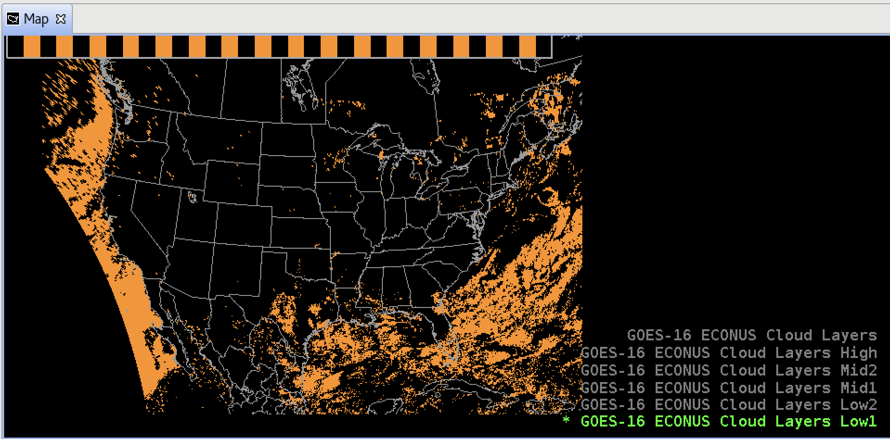
Cloud Layers: LOW1 Clouds <5,000 ft

Slide 13
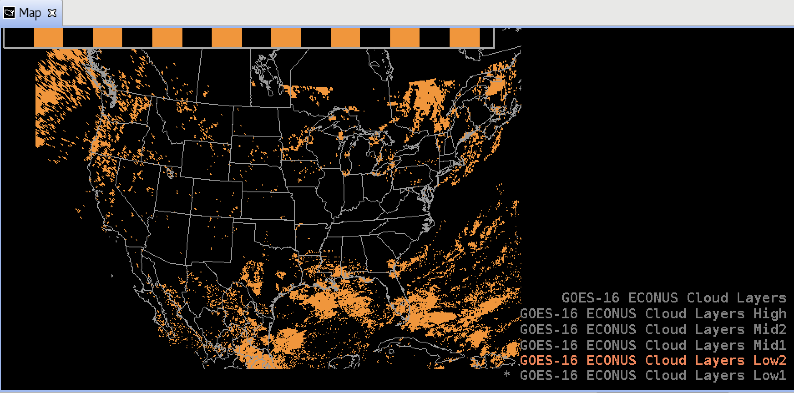
Cloud Layers: LOW2 Clouds 5,000 - 10,000 ft

Slide 14
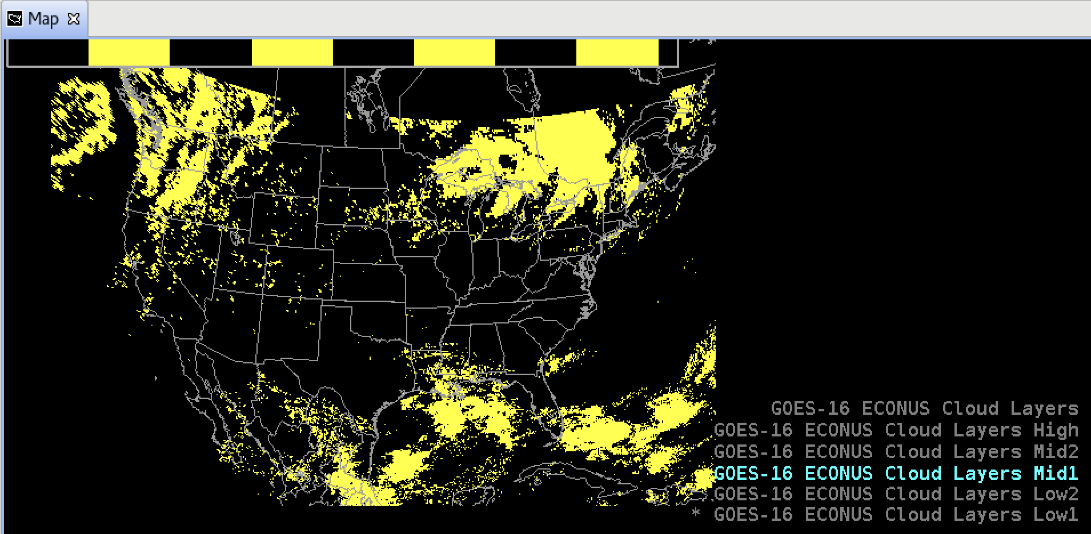
Cloud Layers: MID1 Clouds 10,000 - 18,000 ft

Slide 15
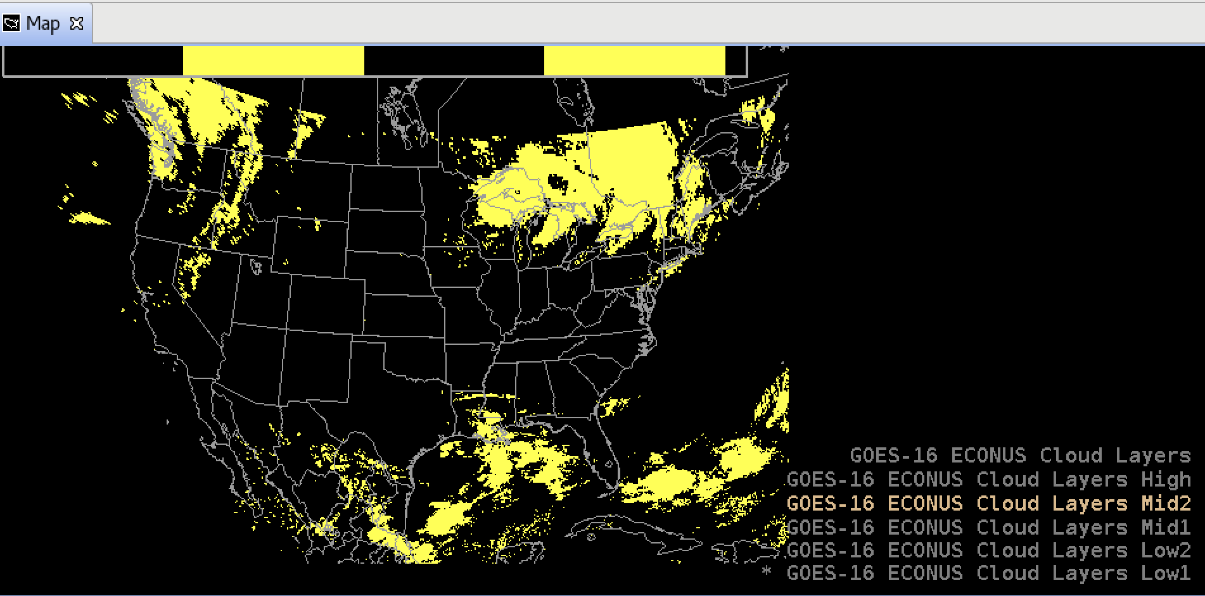
Cloud Layers: MID2 Clouds 18,000 - 24,000 ft

Slide 16
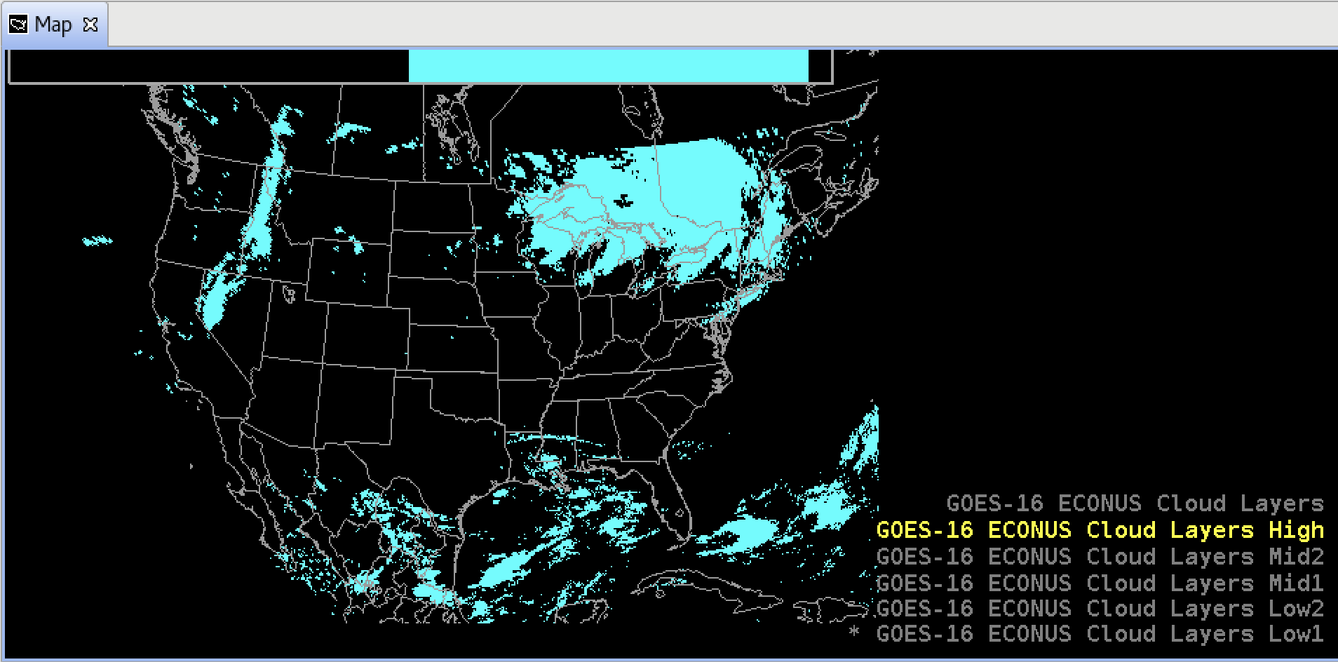
Cloud Layers: HIGH Clouds > 24,000 ft

Slide 17
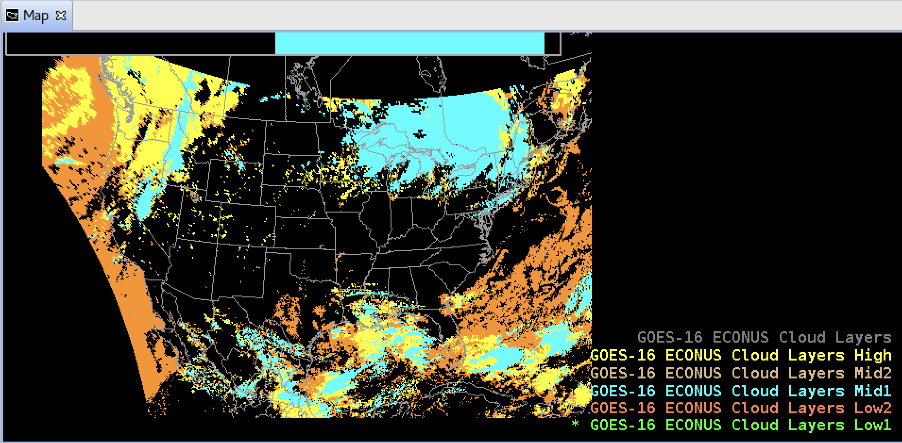
Cloud Layers: All 5 layers - stacked

Slide 18
Usage of GOES-R Cloud Cover Layers in AWIPS
NWS Aviation Weather Center has been using (CIRA’s precursor to) the GOES-R Enterprise CCL product in AWIPS.
Useful for assessing Ceiling and Visibility (C&V)
Terminal Aerodrome Forecasts (TAFs) report atmospheric conditions at various altitudes
CCL product would be especially useful with layers specific to IFR and MVFR: 500-1,000 ft and 1,000-3,000 ft.
Useful for assessing aircraft icing potential
Cold layer (temp < -20°C, ice crystals) just above a Saturated layer (-20°C < temp < 0°C, supercooled liquid) => formation of new ice crystals depletes Liquid Water Content => limits aircraft icing risk
Cold layer (temp < -20°C, ice crystals) above a Dry layer less than 5,000 feet deep above a Saturated layer (-20°C < temp < 0°C, supercooled liquid) => ice crystals sublimate => Liquid Water Content remains high => raises aircraft icing risk
Also useful to know the vertical extent of icing potential, and to characterize supercooled clouds beneath higher clouds.
h/t: Ty Higginbotham, AWC

